Slide 1

Miniproject(19AI701) – Review 2
AI-ENABLED IOT BASED SMART FLOOD ALERT AND PREDICTION SYSTEM
Submitted by:
SHIVRAJ R (212223110051)
GANJI MUNI MADHURI (212223230060)
2023-2027 Batch
TEAM NO: 087
Under the guidance of:
JABA JASPHIN E.T
NAME OF THE GUIDE
JABA JASPHIN E.T
Assistant Professor(SG)
Designation, Department of AIDS
DEPARTMENT OF COMPUTER SCIENCE AND ENGINEERING(IOT)
SAVEETHA ENGINEERING COLLEGE
(Autonomous Institution – UGC, Govt. of India)
(Affiliated to Anna University, Approved by AICTE - Accredited by NBA & NAAC – ‘A’ Grade - ISO 9001:2015 Certified)
Saveetha Nagar, Thandalam, Chennai-602 105, TamilNadu, INDIA.

Slide 2
Agenda
Introduction
Statement of the Problem
  Communication issues during emergencies
  Existing challenges in flood detection
  Need for predictive and intelligent monitoring
Scope of the project
  Functional & Non-functional scope
Methodology
  Architectural Diagram/Flow
  Design - Use Case Diagram, Class Diagram, Sequence Diagram
  Algorithm used
  Implementation
  Important code segments
Output, Results
Test Cases
Conclusions
Future work
References

Slide 3
Introduction
Flood Prediction using AI & IoT
  Floods are one of the most frequent and destructive natural disasters, leading to severe loss of life, economic damage, and infrastructure failure.
  Rapid urbanization and poor drainage systems make cities like Chennai highly vulnerable to flash floods during monsoon seasons.
  Sudden rises in water levels and unexpected heavy rainfall make early flood detection challenging with traditional monitoring systems.
  According to the National Disaster Management Authority (NDMA), timely flood warnings can significantly reduce casualties and improve emergency response effectiveness.
  Early diagnosis and treatment are crucial for improving outcomes.

Slide 4
Statement of the Problem
Challenges in Flood Monitoring and Alerting
  Challenge:
  Time-sensitive detection — many systems only alarm after water has already reached dangerous levels, leaving little or no lead time for evacuation.
  Communication breakdown — power outages and congested/cut cellular networks during heavy storms prevent critical alerts from reaching people on time.
  Reactive threshold logic — static water-level thresholds ignore trends (rate of rise) and rainfall context, producing false alarms or missed events.
  Sensor reliability & data quality — sensors get jammed, obstructed, or drift, and single-sensor readings can be misleading without cross-checks.

Slide 5
Statement of the Problem
  Challenge:
  Sensor reliability & data quality—sensors get jammed, obstructed, or drift, and single-sensor readings can be misleading without cross-checks.
  Lack of predictive integration—existing deployments rarely fuse live sensor feeds with predictive models to forecast risk ahead of time.
  Operational scalability & maintenance — deployments need easy calibration, remote updates, and health monitoring to be practical city-wide
  Objective:
  Design a hybrid edge + cloud system that issues local pre-alerts (fast, offline-capable) and cloud-confirmed official alerts, uses adaptive thresholds and sensor-fusion anomaly checks, and delivers multi-channel warnings (local buzzer, SMS, dashboard) to minimize false positives and maximize lead time.

Slide 6
Scope of the project
Flood Prediction using AI & IoT
  Scope:
  Design, simulate, and pilot a hybrid edge–cloud Smart Flood Alert system that performs real-time monitoring, short-term prediction, and multi-channel alerting for small catchments or urban drain nodes.
  Target Audience: Local disaster management teams, municipal engineers, community volunteers, and campus/civic authorities responsible for flood response.
  Deliverables:
  Working prototype (ESP32 sensor node + Flask server), dashboard demo, ML model (DT/LR + benchmark), alert manager (Twilio sandbox), documentation, and pilot test report.

Slide 7
Scope of the project
Flood Prediction using AI & IoT
  Inclusions:
  Edge pre-alert logic (local buzzer), adaptive thresholding (EWMA/Bayesian), sensor-fusion + anomaly detection, synthetic data augmentation, and evaluation metrics (accuracy, recall, latency).
  Exclusions:
  Full hydrodynamic modeling, city-scale deployment, real-time integration with emergency services (beyond demo SMS), and long-term maintenance contracts.

Slide 8
Scope of the project
Flood Prediction using AI & IoT
  Data:
  Simulated and public historical rainfall/water-level datasets for model training; pilot sensor data collected during field tests for validation.
  Limitations:
  Prototype tested on limited sensors — full uncertainty modeling requires larger deployments.
  Model performance may drop in unforeseen extreme events not present in training data.
  Wireless connectivity and power supply vulnerable during severe storms if backup fails.
  Sensor drift, debris obstruction, and water turbulence can affect data accuracy.
  SMS delivery depends on telecom network stability during emergencies.
  False-negative alerts are costly — tuned conservatively but may increase false positives.

Slide 9
Methodology
Methodology of the Smart Flood Alert System
IoT Data Acquisition
– Ultrasonic water-level & rain sensors on ESP32 continuously measure and send readings.
Edge Pre-Alert Detection
– Device calculates rate of rise; if sudden increase detected → buzzer/LED is activated.
Local Alert for Safety
– Alerts still work even if internet or power fails, ensuring immediate response.
Secure Data Transmission
– Data sent to cloud via MQTT/HTTP with timestamp and pre_alert flag for validation.
Offline Data Buffering
– If network drops, ESP32 stores readings temporarily and auto-uploads later.

Slide 10
Methodology
Data Processing & Cleaning
– Server filters noise, synchronizes timestamps, and validates sensor inputs.
Feature Extraction
– Derives water-level trend, rainfall rate, and sudden-rise indicators.
Machine Learning Prediction
– Decision Tree + Logistic Regression classify Low / Medium / High / Critical risk.
Smart Cloud Confirmation
– Pre-alert from edge is confirmed using ML probability → avoids false alarms.
Edge + Cloud Decision Support
– Cloud confirms alerts and sends SMS/Dashboard warnings, while edge ensures immediate safety.
Tech Stack: ESP32, MQTT/HTTP, Flask + DB, scikit-learn, Twilio, Chart.js

Slide 11
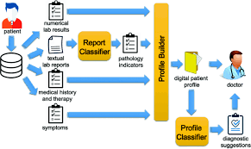
Architecture Diagram/Flow

Slide 12
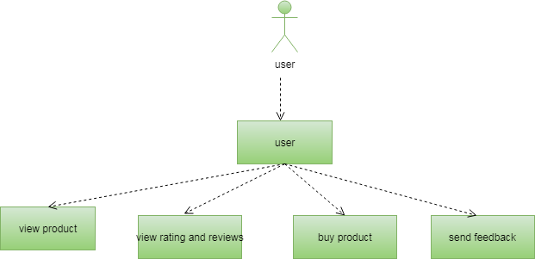
Design-Use Case Diagram
UML DIAGRAMS
Use case Diagram:A use case diagram is a graph of actors set of use cases enclosed by a system boundary, communication associations between the actors and users and generalization among use cases.
The use case model defines the outside (actors) and inside (use case) of the system’s behavior.
USER

Slide 13
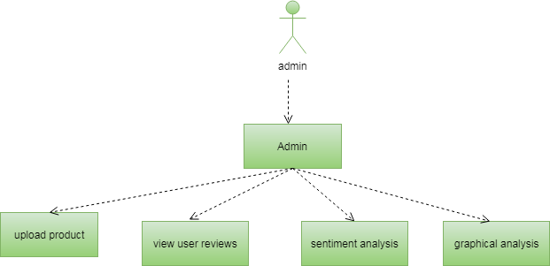
Design-Use Case Diagram
UML DIAGRAMS
ADMIN

Slide 14
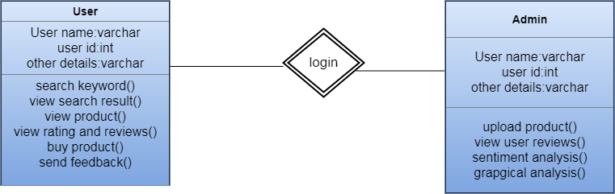
Design-Class Diagram
Class Diagram:A class is a representation of an object and, in many ways; it is simply a template from which objects are created. Classes form the main building blocks of an object-oriented application.
Although thousands of students attend the university, you would only model one class, called Student, which would represent the represent the entire collection of students.

Slide 15
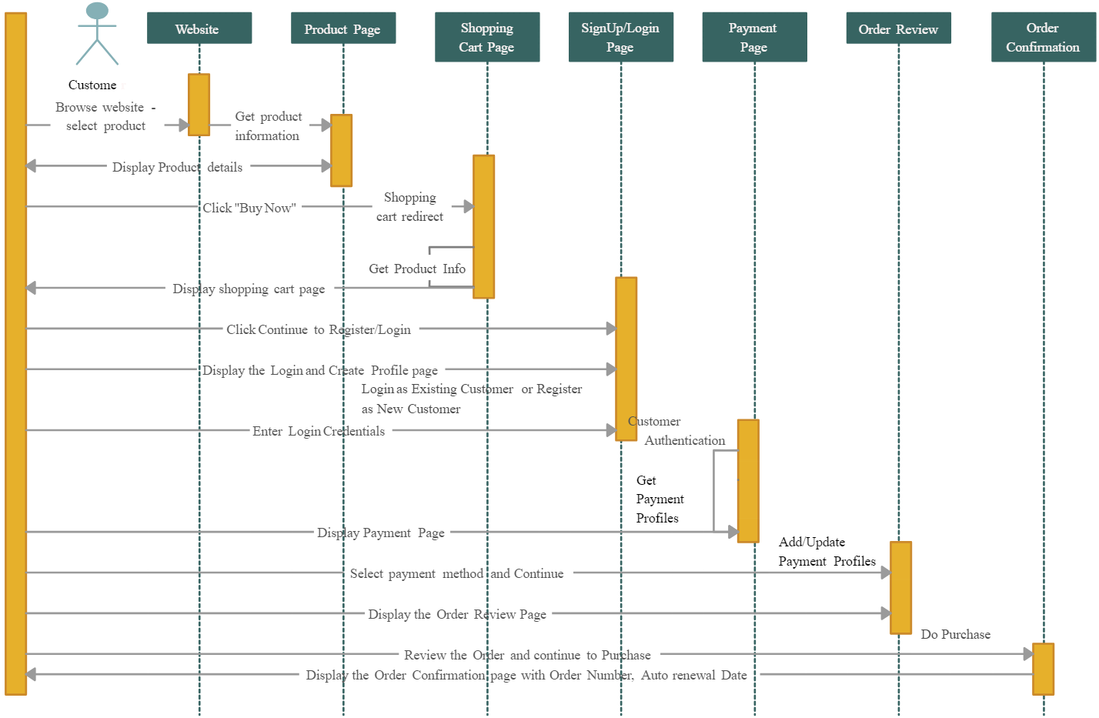
Sequence Diagram - ecommerce example

Slide 16
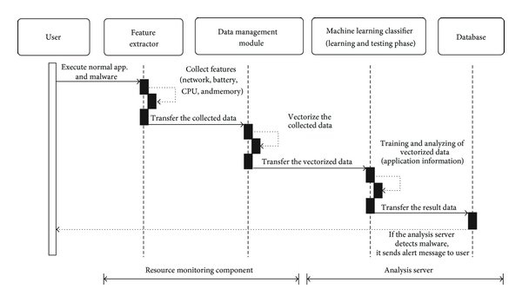
Sequence Diagram
malware detection using machine learnng example

Slide 17
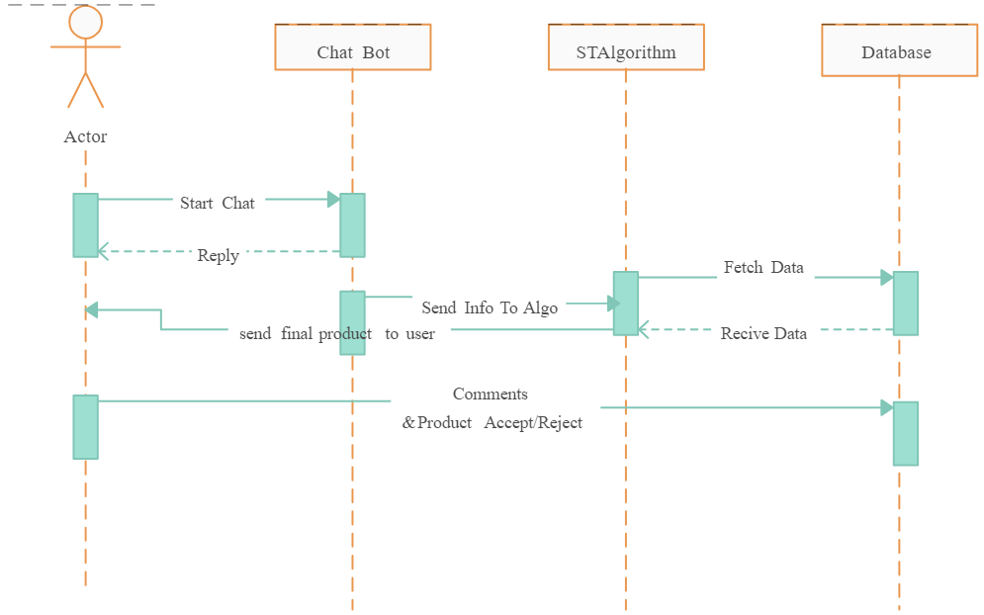
Sequence Diagram
AI Product guide example

Slide 18
Algorithms used
Edge Pre-Alert Algorithm
– Rolling window on recent N readings → compute rate-of-rise = (level_now − level_old) / Δt.
– If rate-of-rise > prealert_threshold → trigger local buzzer & publish pre_alert=true.
– Sampling state machine: NORMAL (60s) → WATCH (15s) → ALERT (5–10s).
Adaptive Thresholding (EWMA baseline)
– Update baseline μₜ = α·xₜ + (1−α)·μₜ₋₁ (α = 0.05–0.2).
– Dynamic threshold = μₜ + k·σₜ (k tuned to balance FP/FN).
Data Cleaning & Windowing
– Median filter to remove spikes; linear interpolation for missing samples.
– Create sliding windows (e.g., 5–15 minute windows) and compute window-level features.
Feature Set (brief)
– Level, rate (Δ), acceleration (Δ²), rolling mean (1h/6h), cumulative rainfall, time-of-day, sensor_health_flag.

Slide 19
Algorithms used
ML Models & Training
– Baseline: Decision Tree + Logistic Regression (interpretable).
– Benchmarks: RandomForest / XGBoost to improve rare-event recall.
– Train with time-aware split and 5-fold CV; handle class imbalance with class weights or SMOTE.
Probability Calibration & Decision Mapping
– Calibrate scores (Platt / isotonic).
– Map calibrated p → actions: p≥0.8 → Critical; 0.6–0.8 → High; else monitor.
Anomaly Detection & Sensor Fusion
– Rule-based checks: (rise && rain≈0 && upstream_no_change) ⇒ mark anomaly & suppress alert.
– Statistical checks: stuck-sensor if identical reading for M cycles; z-score or IsolationForest for outliers.
Alert Inference Logic (compact)
– Priority: If pre_alert received → run immediate cloud inference on latest window.
– If model confirms (label or prob threshold) → Alert Manager sends SMS/Email + log event.
– All events stored for retraining and audit.

Slide 20
Hardware and software selection
• Hardware Used
– ESP32 Microcontroller – Wi-Fi enabled, supports edge processing & low power.
– Ultrasonic Water-Level Sensor – Contactless and accurate measurement.
– Rain Gauge Sensor – Captures real-time rainfall intensity.
– Buzzer / LED – Immediate on-site warning during network failure.
– Power Supply (Battery/Adapter) – Ensures continuous operation.
• Software & Tools
– Arduino IDE – Programming and firmware upload for ESP32.
– MQTT / HTTP Protocols – Secure and reliable IoT data transfer.
– Flask Server + Database – Sensor data ingestion, storage & processing.
– Scikit-learn – Machine learning-based flood risk prediction.
– Chart.js Dashboard + Twilio API – Real-time visualization & SMS alerts.

Slide 21
Implementation
Edge Node Setup
– Assemble ESP32 + ultrasonic + rain sensor, mount in weatherproof enclosure, connect buzzer/LED and power (battery/adapter).
Firmware & Edge Logic
– Implement sampling state machine (NORMAL/WATCH/ALERT), rolling Δ calculation, local pre-alert flag and MQTT/HTTP publish; enable offline buffering.
Cloud Ingest & Storage
– Deploy Flask API to receive sensor JSON, timestamp & persist to DB (InfluxDB/Postgres); implement basic auth and input validation.

Slide 22
Implementation
ML Deployment & Inference
– Train models (DT/LR) offline, export with joblib; host inference service behind API endpoint; implement probability calibration and threshold mapping.
Alert Manager & Dashboard
– Integrate Twilio for SMS; build Flask + Chart.js dashboard with live charts, node health, and “why this alert” panel; log all alerts for audit.
Testing & Pilot
– Run synthetic scenario tests (rapid-rise, noise, comms loss); deploy 3-node pilot, measure accuracy, latency (sensor→SMS), and false-positive rate; iterate thresholds.
Maintenance & Security
– Add OTA updates, TLS/MQTT authentication, sensor calibration schedule, and telemetry for uptime/packet-loss monitoring.

Slide 23
Important Code segments
INPUT DATASET
from admins.models import Prodcuts
from user.forms import UsersForm, PurchaseForm
from user.models import Users, Purchase, Feedback
from user.words import positive_words, negative_words
//Home page for user//
def home(request):
products=Prodcuts.objects.all()
return render(request,'user/home.html',{'products':products})
//View Products page for user//
def viewproduct(request,pk):
pros=Prodcuts.objects.get(id=pk)
uid=request.session['userid']
uses = get_object_or_404(Users, id=uid)
if request.method=="POST":
form=PurchaseForm(request.POST)
if form.is_valid():
ff=form.save(commit=False)
ff.customer=uses

Slide 24
Important Code segments
ff.purhased=pros
ff.totalprice=0
ff.save()
return redirect('user:cart')
else:
form=PurchaseForm()
return render(request,'user/viewproduct.html',{'prod':pro,'ipk':pk,'form':form})
//Cart page for user//
def cart(request):
uid = request.session['userid']
uses = get_object_or_404(Users, id=uid)
p=Purchase.objects.filter(customer=uses,status='incart')
if request.method == "POST":
Purchase.objects.filter(customer=uses, status='incart').update(status='checkout')
return redirect('user:home')
return render(request,'user/cart.html',{'p':p})

Slide 25
Important Code segments
//View ratings page for user//
def viewratings(request,pk):
pro = get_object_or_404(Prodcuts, pk=pk)
fedbck=Feedback.objects.filter(product=pro)
return render(request,'user/viewratings.html',{'feedbacks':fedbck})
//Add ratings page for user//
def addratings(request,pk):
pos,neg=0,0
sen='pending'
pro = get_object_or_404(Prodcuts, pk=pk)
uid = request.session['userid']
uses = get_object_or_404(Users, id=uid)
stat = 'pending'
try:
uud = Purchase.objects.get(customer=uses,purhased=pro,status='purchased')
stat = 'purchased'
except:
stat='not purchased'

Slide 26
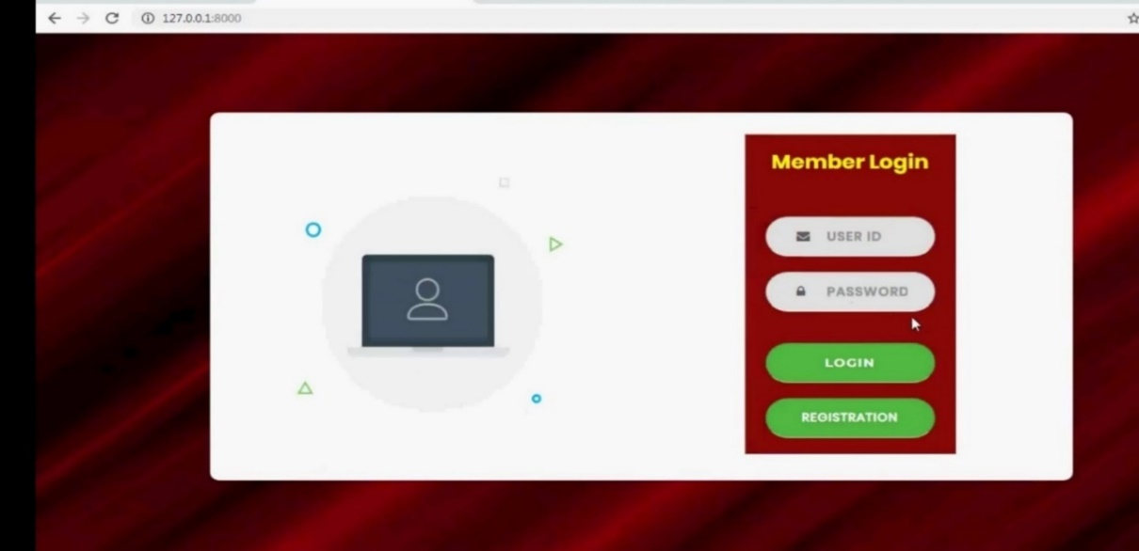
Output
OUTPUT:
After browsing for our website, the following page will be shown first. The user needs to enter Log in details, in case if the person has not registered yet then he/she needs to register for the website.

Slide 27
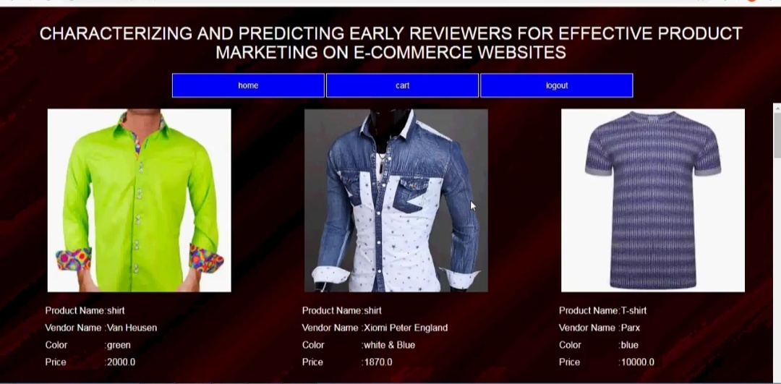
Output
OUTPUT:
After logging in to the website, the following page will be shown to the user.
Home Page

Slide 28
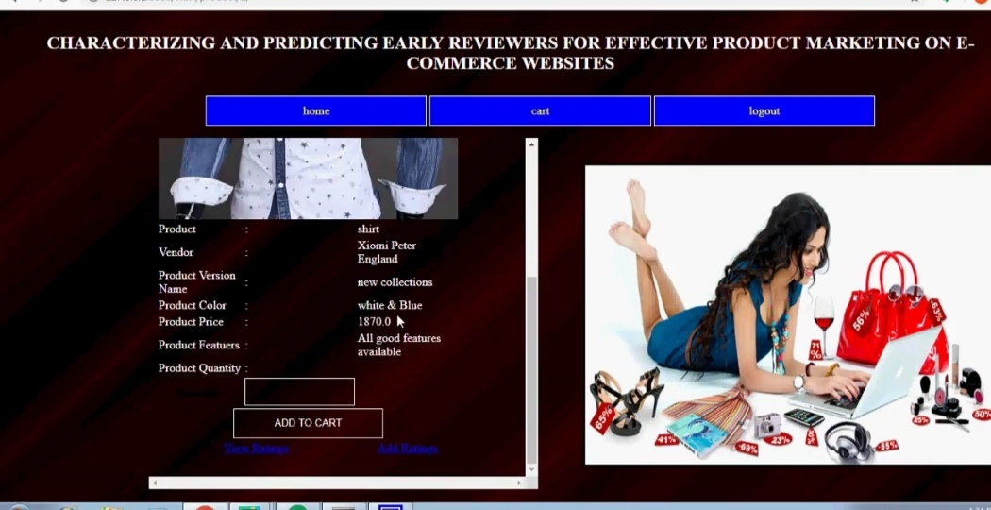
Output
OUTPUT:
If user wants to view the reviews of a product, he/she needs to click the “View Review” option. If he wants to give his review, he needs to click “Add review” option.
View Review Page

Slide 29
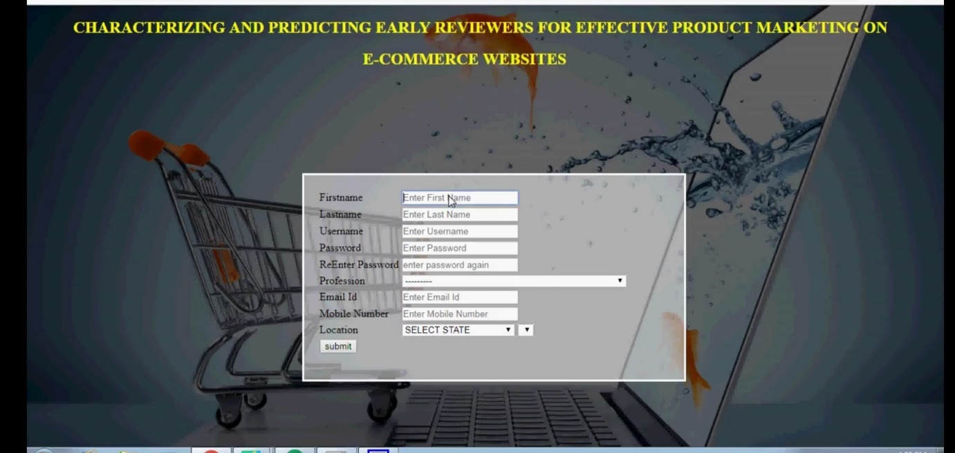
Output
OUTPUT:
The person needs to enter following details for the registration process.
Registration Page

Slide 30
Test Cases
Test Cases
S.NO | Action | Input | Expected output | Actual output | Test Result
1 | Test Case 1: User Registration | Input: New user details (username, email, password). | Expected Output: User account is created successfully, and a confirmation message is displayed. | Actual Output: [To be filled after testing] | Result: Pass/Fail
2 | Test Case 2: User Login | Input: Registered user’s login details (email, password). | Expected Output: User is successfully logged in and redirected to the dashboard. | Actual Output: [To be filled after testing] | Result: Pass/Fail
3 | Test Case 3: Image Upload | Input: X-ray image file uploaded by the user. | Expected Output: Image is uploaded successfully, and a progress bar is displayed. | Actual Output: [To be filled after testing] | Result: Pass/Fail
4 | Test Case 4: Prediction Result Display | Input: Uploaded X-ray image. | Expected Output: Model processes the image, and the prediction result is displayed on the user’s dashboard. | Actual Output: [To be filled after testing] | Result: Pass/Fail
5 | Test Case 5: View Prediction History | Input: Logged-in user navigates to the prediction history page. | Expected Output: List of all previous predictions with dates and results is displayed. | Actual Output: [To be filled after testing] | Result: Pass/Fail

Slide 31
Test Cases
Test Cases (for ecommerce type of projects)
S.NO | Action | Input | Expected output | Actual output | Test Result
1 | The admin uploads product into the website | Product details | The added product should be visible to the customer | The added product should be visible to the customer | Pass
2 | Customer search for product | Product name in the search bar | The respective product should be shown to the user | The product will be available in the list shown to the user | Pass
3 | User gives review to the product | Comment on the product | The comment will be visible in the comment section to all the users | The given comment is not visible because the person did not register in the website | Fail
4 | The user gets the overall review of the product | This is a very good product | Positive | Positive | Pass
5 | User buys the product | Adds the product to the cart and buys the product | The product will be bought by the user | User will get the error because of not log in to the website | Fail

Slide 32
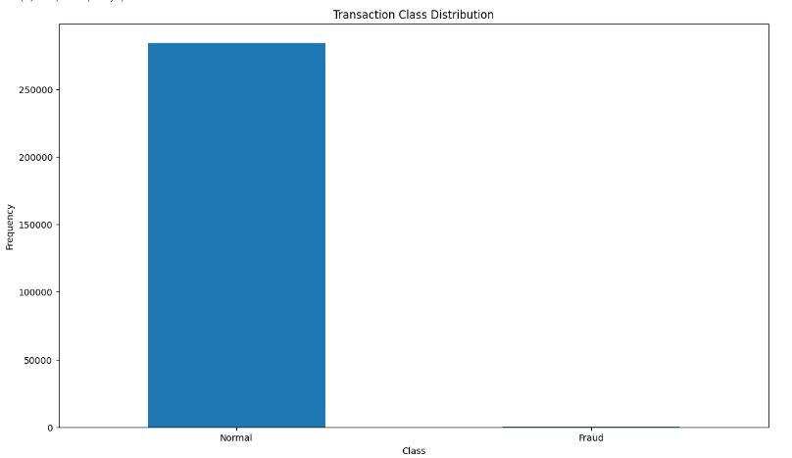
Results
Machine learning
  Accuracy: 90%
  Precision: 93%
  Recall: 92%
  Inferences: Effective predictions, faster diagnosis.

Slide 33
Conclusion
In this Project, our experiments indicate that early reviewer’s ratings and their received helpfulness scores are likely to influence product popularity at a later stage.
So, in these we are using margin based embedding ranking model (MERM) and NLP algorithm for predicting early reviewers in E-Commerce websites. Then the user will instantly get accurate information about the product.

Slide 34
Future Work
In our current work, the review content is not considered. In the future, we will explore effective ways in incorporating review content into our early reviewer prediction model.
We will investigate other sources of in which social networks can be extracted and carry out more insightful analysis.

Slide 35
References
https://en.wikipedia.org/wiki/Object-modeling_technique <Website Link>
Book Reference:
K. F. Victor and I. Z. Michael, “Intelligent data analysis and machine learning: Are they really equivalent Concepts?,” in 2017 Second Russia and Pacific Conference on Computer Technology and Applications (RPC), 2017, pp. 59–63.
Github link of project
Video link of project demo

Slide 36

Questions

Slide 37


